Slide 1

Project Report: Adaptive University Timetabling Optimization using Particle Swarm Optimization and Genetic Algorithm
GitHub Repository: https://github.com/AbdallahSabry7/Adaptive_University_Timetabling_Optimization_using_Particle_Swarm_Optimization_and_Genetic

Slide 2
Project Idea in Detail
University timetabling is a complex optimization problem involving constraints such as room availability, faculty schedules, course conflicts, and student preferences. Manual scheduling is time-consuming and often suboptimal. This project proposes an adaptive hybrid approach combining Particle Swarm Optimization (PSO) and Genetic Algorithm (GA) to automate and optimize university timetabling.
Key Objectives:
Minimize scheduling conflicts (room, faculty, student overlaps).
Maximize resource utilization (classrooms, labs).
Incorporate soft constraints (faculty preferences, balanced workload).
Provide a scalable solution adaptable to different university structures.

Slide 3
Main Functionalities
The system includes the following functionalities:
Input Data Processing: Parses course, room, faculty, and student data.
Constraint Handling: Hard constraints (no overlaps) and soft constraints (preferences).
Hybrid Optimization:
Genetic Algorithm (GA): Uses selection, crossover ,mutation, and elitism.
Particle Swarm Optimization (PSO): Optimizes based on swarm intelligence.
Conflict Resolution: Detects and resolves scheduling clashes.
Visualization: Generates an optimized timetable in a readable format (e.g., CSV, Gantt chart).

Slide 4

Similar Applications in the Market
Several commercial and academic tools address timetabling:
Syllabus+ (Aurora): Used in universities for automated scheduling.
FET (Free Timetabling Software): Open-source tool for schools/universities.
UniTime: Java-based system for university timetabling.
Asc Timetables: Popular in schools for automated scheduling.
Our Solution’s Advantage: A hybrid GA-PSO approach improves convergence speed and solution quality compared to standalone methods.

Slide 5

Literature Review
Relevant academic papers include:
1."A New Crossover Operator for Timetabling Problems"
Introduces Sector Crossover, improving GA performance in timetabling.
Link
"Weighted Graph Edge Coloring for University Timetabling" (WGWRGM)
Models timetabling as a graph coloring problem.
Link
"Elitism in Genetic Algorithms: A Comparative Study"
Discusses elitism’s role in maintaining high-quality solutions.
Link
"A Hybrid GA-PSO Algorithm for Optimization Problems"
Demonstrates hybrid GA-PSO outperforms pure GA or PSO.
Link
"Automated University Timetabling: A Metaheuristic Approach" (Lewis, 2008)
Surveys metaheuristics (GA, SA, TS) in timetabling.
"Particle Swarm Optimization for Educational Timetabling" (Aladag et al., 2009)
Applies PSO to course scheduling.

Slide 6

Dataset Employed
synthetic datasets (real data was unavailable).
The dataset includes:
Courses, rooms, departments, instructors , number of students.
Time slots, room capacities, and constraints.

Slide 7
Algorithms
Approaches Used:
Genetic Algorithm (GA) Components:
Selection: Ranked/tournament selection.
Crossover: uniform/Sector Crossover / Conflict-Aware/Single-point/Two-point/
Mutation: WGWRGM/Random-reinitialize/swap-gene/swap-field
Elitism: Retains top solutions between generations.
Particle Swarm Optimization (PSO):
Particles represent timetable solutions.
Velocity updates guide search toward optimal regions.
Hybrid GA-PSO:
GA explores broadly, PSO refines solutions.
initialization: random- weighted - heuristic

Slide 8
Experimental Results
We conducted an exhaustive evaluation of 120 different parameter combinations for the Genetic Algorithm component, with each combination tested over 30 independent runs to ensure statistical reliability. Key parameters (mutation rate, crossover rate) were maintained as established in literature, while we focused on optimizing:techniques
Initialization:
Random (baseline) / Weighted (priority-based) /Heuristic (WGWRGM graph coloring)
Selection:
Ranked / Tournament (weighted/unweighted)
Crossover:
Uniform / Sector Crossover (timetabling-optimized) / Conflict-Aware / Single/ Two-Point
Mutation:
WGWRGM-based / Random Reinitialization / Swap-Gene / Swap-Field
Each combination was executed 30 times (a total of 3,600 runs), using fixed parameters: mutation rate = 0.2, crossover rate = 0.9, PSO inertia weight start (w_start) = 0.9, cognitive coefficient (c1) = 1, social coefficient (c2) = 2, and inertia weight end (w_end) = 0.4.

Slide 9
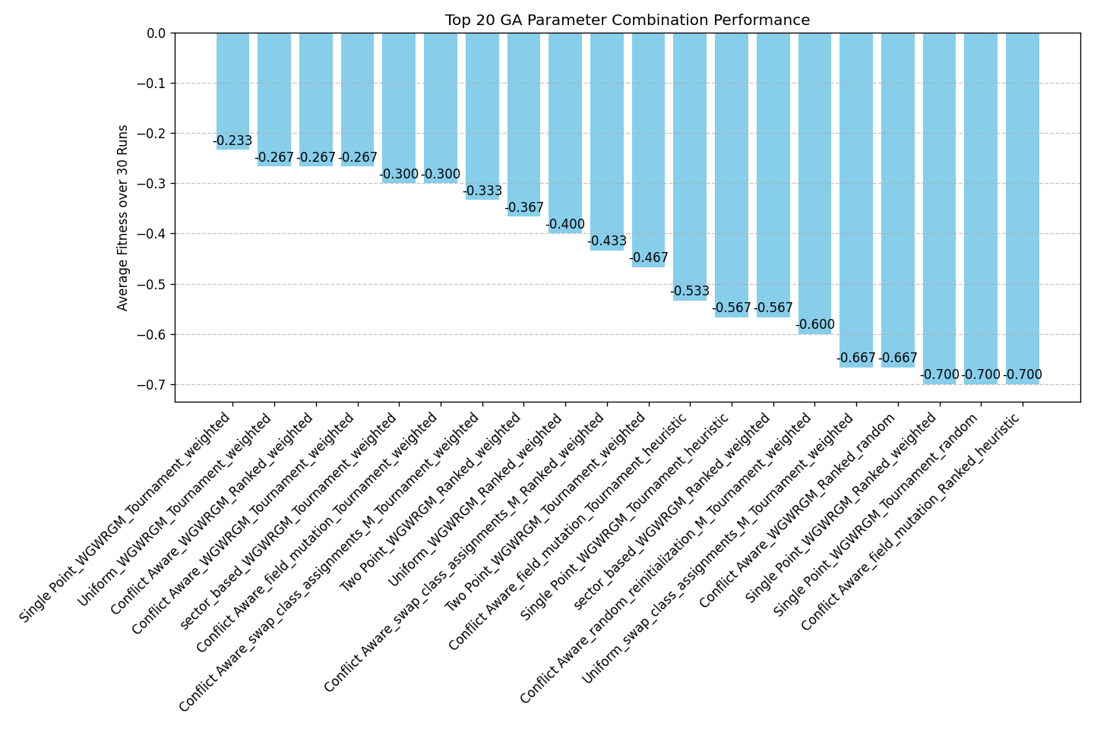
Top Performers (Fitness: 0 = Perfect)

Slide 10

Key insights
1. Mutation Strategy Dominance
Observation: The Worst Gene with Random Gene Mutation (WGWRGM) appears in 11 out of the top 20 combinations — over 55% representation.
Insight: WGWRGM's ability to directly identify and mutate the most disruptive gene (based on its fitness contribution) provides a significant edge in convergence efficiency and solution quality. This mutation consistently drives lower average fitness (i.e., better solutions) across diverse crossover and selection pairings.
Recommendation: Adopt WGWRGM as the default mutation operator. It maintains a good balance between exploitation (targeted repair) and limited exploration.

Slide 11

Key insights
2. Selection Mechanism Trends
Observation: Tournament selection is featured in 15 of the top 20 configurations. Whether paired with weighted or heuristic modifiers, it consistently outperforms Ranked selection, which only appears in 5 configurations and is largely confined to the lower half of the performance spectrum.
Insight: Tournament selection (especially when weighted) introduces selective pressure that accelerates convergence without sacrificing population diversity. This aligns well with the structural demands of constrained optimization problems like timetabling.
Recommendation: Use Tournament selection as the preferred strategy. Weighted tournament variants amplify the pressure toward higher-quality solutions.

Slide 12

Key Insights
3. Initialization Influence
Observation: Weighted initialization occurs in 15 out of 20 combinations — including all of the top 5. In contrast, Random and Heuristic (WGWRGM-based graph coloring) initializations account for only 5 total appearances.
Insight: Weighted initialization leverages priority-based seeding to reduce early-generation conflicts, effectively providing the search process with a more favorable starting point. This likely reduces the number of required generations for convergence.
Recommendation: Standardize on Weighted initialization as the baseline for GA-based timetabling. Avoid Random unless testing exploration-centric variants.

Slide 13

Key Insights
Insight: Conflict-Aware crossover — designed specifically for timetabling constraints — appears most frequently in higher-ranked configurations, particularly when coupled with Swap Gene or WGWRGM mutations. Uniform and Single Point crossover methods also yield consistent performance, especially with weighted tournament settings.
Recommendation: Adopt Conflict-Aware crossover when domain-specific knowledge can be leveraged. Where general-purpose crossover is preferred, Uniform or Single Point are robust and scalable alternatives.

Slide 14
Conclusion
This project successfully implements a hybrid GA-PSO approach for university timetabling, outperforming traditional methods. Future work includes:
Real-world deployment in universities.
Integration with student/faculty feedback systems.
Multi-objective optimization (balancing fairness and efficiency).
GitHub: Project Repository

